Slide 1

Noida Institute of Engineering and Technology, Greater Noida
Design and Analysis of Algorithms: Trees
Unit: 1
SUBJECT NAME:- DATA STRUCTURES AND ALGORITHMS-II
SUBJECT CODE:- (BCSEH0401/BMICSE0401)
COURSE: B.Tech
BRANCH: CSE-R & M.Tech (Int.)
SECTION: A
Mr. Shamshad Ali
B.Tech(IT), M.Tech(CSE), Ph.D(Pursuing)
Assistant Professor
Department of CSE
NIET, Greater Noida

Slide 2
Faculty Introduction
NAME | Mr. Shamshad Ali
QUALIFICATION | B.Tech(IT), M.Tech(CSE), PhD(Pursuing)
DESIGNATION | Assistant Professor
DEPARTMENT | Data Science
TOTAL EXPERIENCE | 15+ Years(BBIET & RC, NCET, NIET)
NIET EXPERIENCE | 8 Months
SUBJECT TAUGHT | DSA-I, DSA-II, DAA, DS, TAFL, CNS, SE, OS, C, OOP with C++, DBMS etc.

Slide 3

Evaluation Scheme

Slide 4

Syllabus Contents
UNIT-I: Design and Analysis of Algorithms: Trees
Module 1.1: Trees
Basic terminology used with Tree, Binary Trees, Binary Tree Representation: Array Representation and Pointer (Linked List) Representation, Binary Search Tree, Strictly Binary Tree, Complete Binary Tree, An Extended Binary Trees. Tree Traversal algorithms: In-order, Pre-order and Post-order. Constructing Binary Tree from given Tree Traversal, Operation of Insertion, Deletion, Searching & Modification of data in Binary Search tree, Binary Heaps, Heap sort, Threaded Binary trees, Traversing Threaded Binary trees, AVL Tree.
Module 1.2: Application of Trees
B-Tree & Binary Heaps, Heap sort.

Slide 5
Syllabus Contents
UNIT-II: Design and Analysis of Algorithms: Graphs
Module 2.1: Graphs
Terminology used with Graph, Data Structure for Graph Representations: Adjacency matrices, Adjacency List. Graph Traversal: Depth First Search and Breadth First Search. Connected Component, Spanning Trees.
Module 2.2: Algorithms on Graphs
Minimum Cost Spanning Trees: Prim’ s and Kruskal’s algorithm. Directed- Acyclic Graph, Transitive Closure and Shortest Path algorithms: Dijkstra Algorithm, Bellman Ford Algorithm, Floyd Warshall’s Algorithm.

Slide 6
Syllabus Contents
UNIT-III: Dynamic Programming
Module 3.1: Dynamic Programming
Dynamic Programming concepts 0/1 Knapsack, Longest Common Sub Sequence, Matrix Chain Multiplication, Resource Allocation Problem.

Slide 7
Syllabus Contents
UNIT-IV: Backtracking, Branch and Bound
Module 4.1: Backtracking
Backtracking, Branch, and Bound with Examples Such as Travelling Salesman Problem, Graph Colouring, n-Queen Problem, Hamiltonian Cycles, and Sum of Subsets.

Slide 8
Syllabus Contents
UNIT-V: Advanced Data Structures
Module 5.1
Red-Black Trees, B – Trees, B+ Trees, Binomial Heaps, Fibonacci Heaps, Trees.

Slide 9
Branch-wise Applications
COMPUTER SCIENCE AND ENGINEERING
OPTIMIZATION: Enhancing performance of software and hardware through efficient algorithms
DATABASE MANAGEMENT: Use data structure like B-tree and hashing for efficient data storage and retrieval.
NETWORKING: Algorithms for routing, data compression and error detection.
OPERATING SYSTEM: Implementation of scheduling algorithm, memory management and file management.

Slide 10
Branch-wise Applications
COMPUTER SCIENCE AND ENGINEERING (AI)
MACHINE LEARNING: Use of algorithms like decision tree, neural networks and clustering for learning of data.
NATURE LANGUAGE PROCESSING: Algorithms for parsing, sentiment analysis and machine translation.
SEARCH ALGORITHMS: Implementing A*, Minimax for problem-solving and game-playing
PATTERN RECOGNISTION: Efficiently classify and detect patterns in data using suitable data structures

Slide 11
Branch-wise Applications
COMPUTER SCIENCE AND ENGINEERING(AIML)
DEEP LEARNING: Implement and optimize neural network architectures.
REINFORCEMENT LEARNING: Algorithms like Q-training for decision making strategy development.
FEATURE ENGINEERING: Use data structures for efficient feature extraction and selection.
MODEL EVALUATION: Algorithms for cross-validation and hyper parameter tuning to enhance model performance.

Slide 12
Branch-wise Applications
COMPUTER SCIENCE AND ENGINEERING(DS)
DATA MINING: Algorithm for clustering, classification and association rule learning.
BIG-DATA ANALYTICS: Data Structures like Hadoop Distributed File System (HDFS) and MapReduce Algorithms.
PREDICTIVE ANALYSIS: Use time-series algorithms and regression model to forecast trends.
DATA CLEANING: Efficiently handle and preprocess large datasets using suitable data structures.

Slide 13
Branch-wise Applications
COMPUTER SCIENCE AND ENGINEERING(IoT)
SENSOR DATA PROCESSING: Algorithms for real-time data collection, filtering and analysis.
NETWORK PROTOCOLS: Design and Analysis of Algorithms for efficient data transmission in IoT networks.
EDGE COMPUTING: Optimize algorithms for data processing on edge devices.
SECURITY: Implementing algorithms for encryption, authentication and intrusion detection in IoT system.

Slide 14
Branch-wise Applications
COMPUTER SCIENCE AND ENGINEERING (CYBER SECURITY)
CRYPTOGRAPHY: Design and analyze algorithms for secure communication.
INTRUSION DETECTION: Use of data structures for pattern matching to detect unauthorized access.
MALWARE ANALYSIS: Algorithms to detect and analyze malicious code.
NETWORK SECURITY: Implement and analyze algorithms for firewall and secure routing protocols

Slide 15
Course Objectives
STUDENTS WILL TRY TO LEARN:
To impart the basic concepts of Advanced data structures and algorithms.
To understand concepts about Trees and Graphs data structures.
To Understand basic concepts of Dynamic Programming.
To understanding the basic concepts of Backtracking
To understanding the basic concepts of Height balanced trees.

Slide 16
Course Outcomes (CO’s)
At the end of course, the student will be able to:
CO1 : Apply tree structures effectively demonstrating proficiency in tree operations and algorithms.
CO2 : Analyze the graph data structure and implement various operations for problem solving.
CO3 : Implementation and analysis of dynamic programming for efficient problem-solving across diverse contexts.
CO4 : Apply efficient backtracking and branch &bound techniques across diverse problem-solving scenarios.
CO5 : Understand advanced data structures, their implementation and application for efficient data manipulation and retrieval.

Slide 17
Program Outcomes (PO’s)
Engineering Graduates will be able to:
PO1 : Engineering Knowledge
PO2 : Problem Analysis
PO3 : Design/Development of solutions
PO4 : Conduct Investigations of complex problems
PO5 : Modern tool usage
PO6 : The engineer and society

Slide 18
Program Outcomes (PO’s)
Engineering Graduates will be able to:
PO7 : Environment and sustainability
PO8 : Ethics
PO9 : Individual and teamwork
PO10 : Communication
PO11 : Project management and finance

Slide 19
COs-POs Mapping
CO.K | PO1 | PO2 | PO3 | PO4 | PO5 | PO6 | PO7 | PO8 | PO9 | PO10 | PO11
CO1
CO2
CO3
CO4
CO5
AVG

Slide 20
Program Specific Outcomes (PSO’s)
S.NO | PROGRAM SPECIFIC OUTCOMES (PSO) | PSO DESCRIPTION
1 | PSO1 | Identify, analyze real world problems and design their ethical solutions using artificial intelligence, robotics, virtual/ augmented reality , data analytics, block chain technology and cloud computing.
2 | PSO2 | Design and Develop the hardware sensor devices and related interfacing software systems for solving complex engineering problems.
3 | PSO3 | Understanding inter-disciplinary computing technique and to apply them in the design of advanced computing.
4 | PSO4 | Conduct investigation of complex problems with the help of technical, managerial, leadership qualities, and modern engineering tools provided by industry-sponsored laboratories.

Slide 21
CO’s-PSO’s Mapping
CO.K | PSO1 | PSO2 | PSO3 | PSO4
CO1
CO2
CO3
CO4
CO5

Slide 22
Program Educational Objectives (PEO’s)
PROGRAM EDUCATIONAL OBJECTIVES (PEO’s) | PEO’s DESCRIPTION
PEO1 | To have an excellent scientific and engineering breadth so as to comprehend, analyze, design and provide sustainable solutions for real-life problems using state-of-the-art technologies.
PEO2 | To have a successful career in industries, to pursue higher studies or to support entrepreneurial endeavors and to face the global challenges.
PEO3 | To have an effective communication skills, professional attitude, ethical values and a desire to learn specific knowledge in emerging trends, technologies for research, innovation and product development and contribution to society.
PEO4 | To have life-long learning for up-skilling and re-skilling for a successful professional career as an engineer, scientist, entrepreneur or bureaucrat for the betterment of the society.

Slide 23
PRE-REQUISITE FOR THE SUBJECT
S.NO | TOPIC | UNDERSTANDING
1 | PROGRAMMING | BASIC UNDERSTANDING OF C AND PYTHON.
2 | ARRAYS | CREATION OF ARRAYS
 | POINTERS | BASIC UNDERSTANDING OF WORKING WITH POINTERS (C LANGUAGE)
4 | CLASS | CREATION OF CLASS AND IT’S OBJECTS.
5 | LINKED LISTS | NODE STRUCTURE, MEMORY ALLOCATIONs.

Slide 24
BRIEF INTRODUCTION ABOUT THE SUBJECT WITH VIDEOS
Video Links:
https://infyspringboard.onwingspan.com/web/en/app/toc/lex_auth_0125409699132620801065_shared/overview
https://infyspringboard.onwingspan.com/web/en/app/toc/lex_auth_0135015662906327049522/overview
https://infyspringboard.onwingspan.com/web/en/app/toc/lex_auth_01317717336104140852_shared/overview
Above Links will give you a brief reference of Subject.

Slide 25
Brief Introduction with Video
What is Data Structure?
Data Structures is one of the foundation courses in Computer Science.
Essentially, it includes concepts such as stacks, queues, graphs, algorithm analysis, sorting algorithms, linked lists, and set implementations (binary search trees and hash tables).
Learning Data Structures helps in writing optimized code.
It is important to develop the algorithm in the most optimized way possible which can only be achieved by someone who has a sound knowledge of all the major data structures and algorithms.
Video Link:
https://www.youtube.com/watch?v=xLetJpcjHS0

Slide 26
Unit Content
Basic terminologies with Tree
Binary Tree
  Binary tree representation
  Binary tree traversal
Binary Search tree
Tree Traversal Algorithms
  In-order and Post-Order
Threaded Binary tree
AVL Tree
B-Tree
Binary Heaps
Heap Sort

Slide 27
Unit Objective
To understand Tree and its use
  To know basic terminologies of tree Understand Binary Tree
  Binary tree representation
  Binary tree traversal
To learn Binary Search tree
To study Threaded Binary tree
Understand Huffman Coding
To learn AVL Tree and B-Tree
To study Heap Sort

Slide 28
Topic Objective
To study Tree
  Tree terminology
Understand Binary Tree
  Binary tree representation
  Binary tree traversal
To learn Binary Search tree

Slide 29
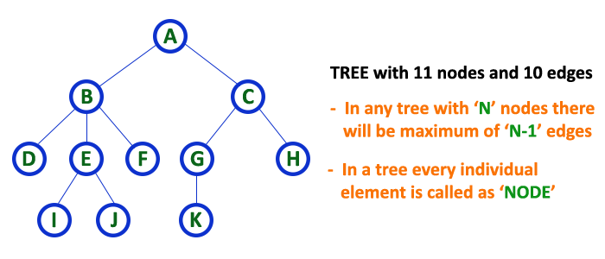
Tree (CO1)
A tree is a very popular non-linear data structure used in a wide range of applications. A tree data structure can be defined as follows...
  Tree is a non-linear data structure which organizes data in hierarchical structure and this is a recursive definition.
  OR
  Tree data structure is a collection of data (Node) which is organized in hierarchical structure recursively
In tree data structure, every individual element is called as Node
In a tree data structure, if we have N number of nodes then we can have a maximum of N-1 number of links.
  Example:-

Slide 30
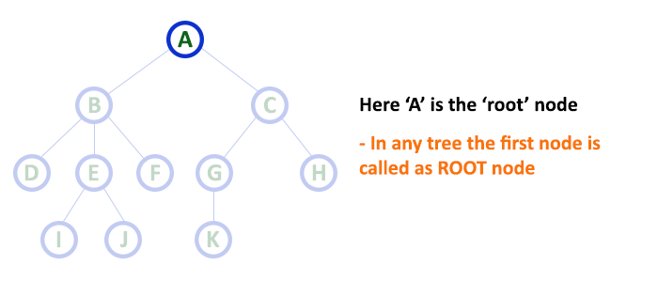
Tree Terminology
Root
  In a tree data structure, the first node is called as Root Node.
  Every tree must have a root node.
  Root node is the origin of the tree data structure.
  In any tree, there must be only one root node.

Slide 31
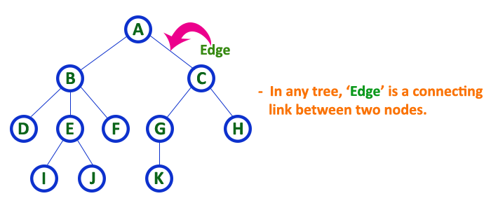
Tree Terminology
Edge
  In a tree data structure, the connecting link between any two nodes is called as EDGE.
  In a tree with 'N' number of nodes there will be a maximum of 'N-1' number of edges.

Slide 32
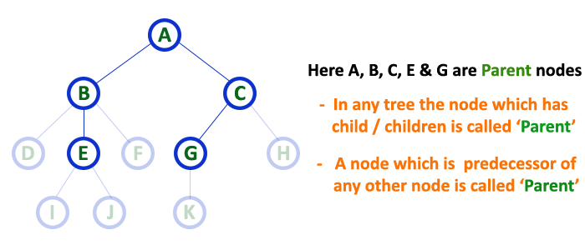
Tree Terminology
Parent
  In a tree data structure, the node which is a predecessor of any node is called as PARENT NODE.
  In simple words, the node which has a branch from it to any other node is called a parent node.
  Parent node can also be defined as "The node which has child / children".

Slide 33
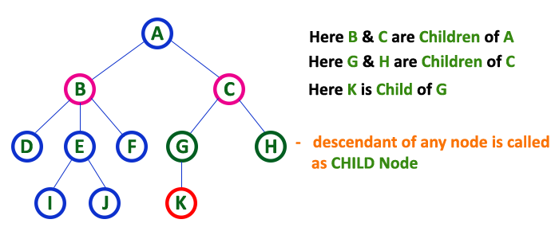
Tree Terminology
Child
  In a tree data structure, the node which is descendant of any node is called as CHILD Node.
  In simple words, the node which has a link from its parent node is called as child node.
  In a tree, any parent node can have any number of child nodes.
  In a tree, all the nodes except root are child nodes.

Slide 34
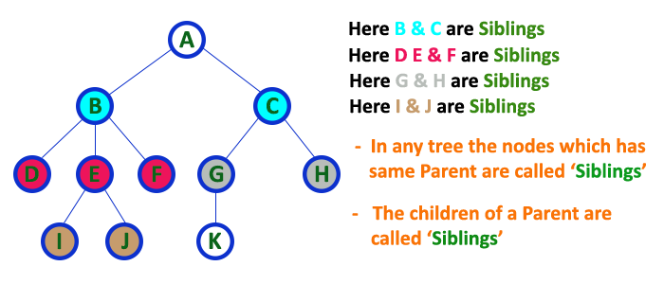
Tree Terminology
Siblings
  In a tree data structure, nodes which belong to same Parent are called as SIBLINGS.
  In simple words, the nodes with the same parent are called Sibling nodes

Slide 35
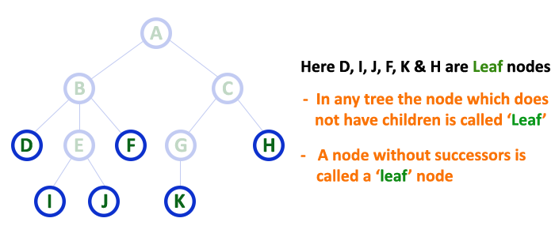
Tree Terminology
Leaf
  In a tree data structure, the node which does not have a child is called as LEAF Node.
  In simple words, a leaf is a node with no child.
  In a tree data structure, the leaf nodes are also called as External Nodes.
  In a tree, leaf node is also called as 'Terminal' node.

Slide 36
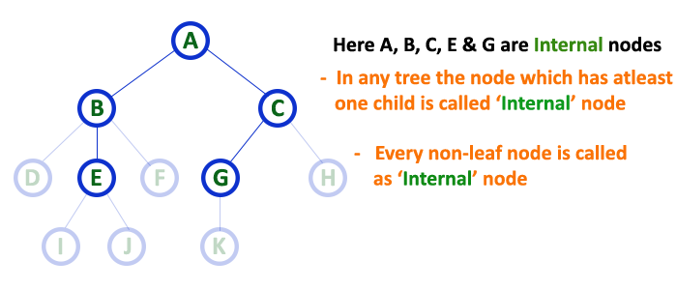
Tree Terminology
Internal Nodes
  In a tree data structure, the node which has atleast one child is called as INTERNAL Node.
  In a tree data structure, nodes other than leaf nodes are called as Internal Nodes.
  The root node is also said to be Internal Node if the tree has more than one node.
  Internal nodes are also called as 'Non-Terminal' nodes.

Slide 37
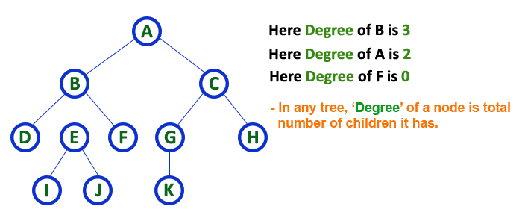
Tree Terminology
Degree
  In a tree data structure, the total number of children of a node is called as DEGREE of that Node.
  The highest degree of a node among all the nodes in a tree is called as 'Degree of Tree'

Slide 38
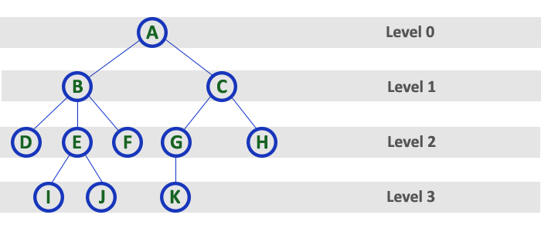
Tree Terminology
Level
  In a tree data structure, the root node is said to be at Level 0 and the children of root node are at Level 1 and the children of the nodes which are at Level 1 will be at Level 2 and so on...
  In simple words, in a tree each step from top to bottom is called as a Level and the Level count starts with '0' and incremented by one at each level (Step).

Slide 39
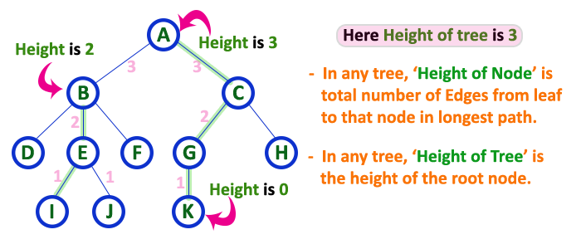
Tree Terminology
Height
  In a tree data structure, the total number of edges from leaf node to a particular node in the longest path is called as HEIGHT of that Node.
  In a tree, height of the root node is said to be height of the tree.
  In a tree, height of all leaf nodes is '0'.

Slide 40
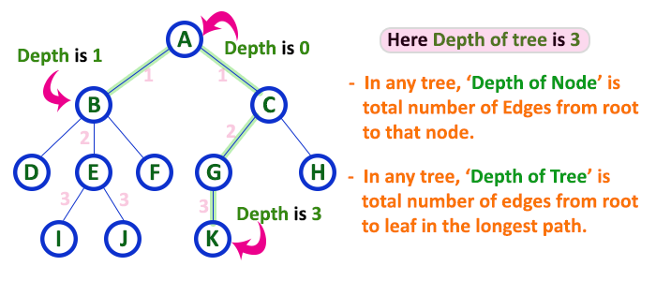
Tree Terminology
Depth
  In a tree data structure, the total number of egdes from root node to a particular node is called as DEPTH of that Node.
  In a tree, the total number of edges from root node to a leaf node in the longest path is said to be Depth of the tree.
  In a tree, depth of the root node is '0'.

Slide 41
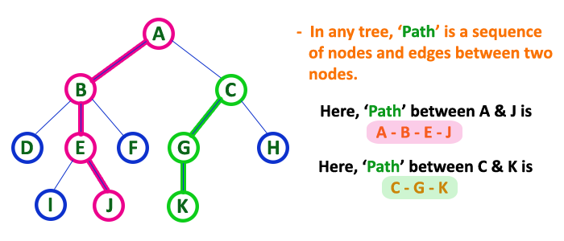
Tree Terminology
Path
  In a tree data structure, the sequence of Nodes and Edges from one node to another node is called as PATH between that two Nodes.
  Length of a Path is total number of nodes in that path.
  In below example the path A - B - E - J has length 4.

Slide 42
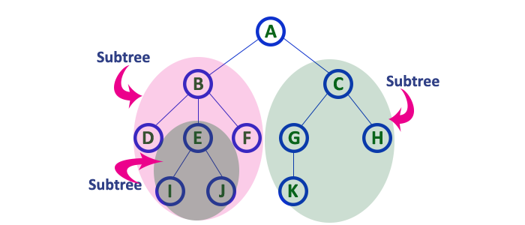
Tree Terminology
Sub Tree
  In a tree data structure, each child from a node forms a subtree recursively.
  Every child node will form a subtree on its parent node.

Slide 43
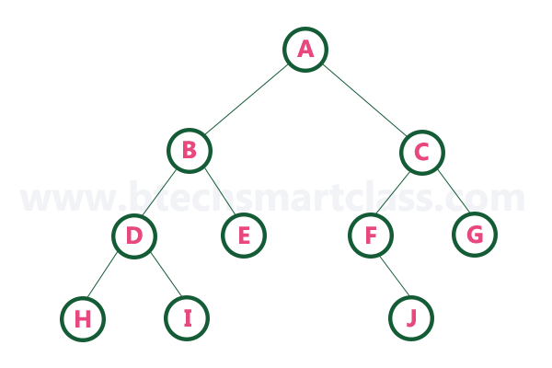
Binary Tree (CO1)
In a normal tree, every node can have any number of children.
A binary tree is a special type of tree data structure in which every node can have a maximum of 2 children.
One is known as a left child and the other is known as right child.
A tree in which every node can have a maximum of two children is called Binary Tree.
In a binary tree, every node can have either 0 children or 1 child or 2 children but not more than 2 children.
  Example

Slide 44

Trees
Binary Tree(Properties)
1) The maximum number of nodes at level ‘l’ of a binary tree is 2^{l}.
Here level is the number of nodes on the path from the root to the node (including root and node). Level of the root is 0.
This can be proved by induction.
For root, l = 0, number of nodes = 2⁰ = 1
Assume that the maximum number of nodes on level ‘l’ is 2^{l}
Since in Binary tree every node has at most 2 children, next level would have twice nodes, i.e. 2 * 2^{l}
2. The Maximum number of nodes in a binary tree of height ‘h’ is 2^{h+1} – 1.
3. In a Binary Tree with N nodes, minimum possible height or the minimum number of levels is?
log₂(N+1) -1

Slide 45
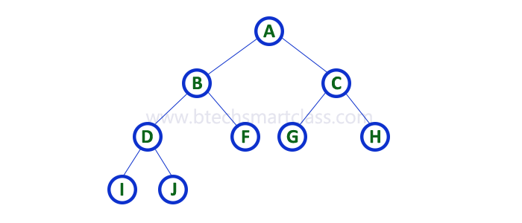
Binary Tree
Strictly Binary Tree
  A binary tree in which every node has either two or zero number of children is called Strictly Binary Tree
  Strictly binary tree is also called as Full Binary Tree or Proper Binary Tree or 2-Tree

Slide 46
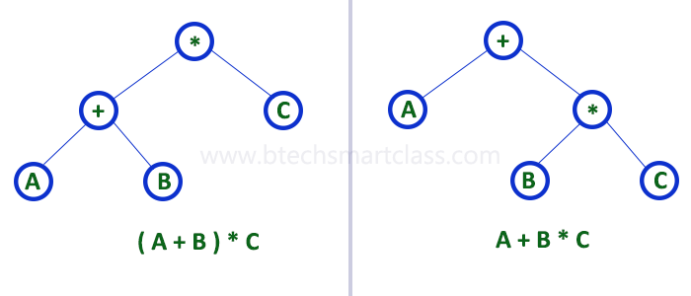
Binary Tree
Strictly binary tree data structure is used to represent mathematical expressions.

Slide 47
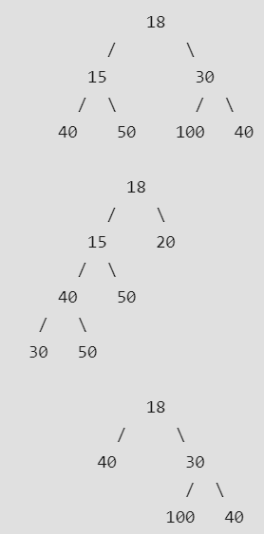
Trees
Full Binary Tree
In a Full Binary Tree, number of leaf nodes is the number of internal nodes plus 1
L = I + 1
Where L = Number of leaf nodes, I = Number of internal nodes

Slide 48
Trees
FULL Binary Tree theorem
Theorem: Let T be a nonempty, full binary tree Then:
If T has I internal nodes, the number of leaves is L = I + 1.
If T has I internal nodes, the total number of nodes is N = 2I + 1.
If T has a total of N nodes, the number of internal nodes is I = (N – 1)/2.
If T has a total of N nodes, the number of leaves is L = (N + 1)/2.
If T has L leaves, the total number of nodes is N = 2L – 1.
If T has L leaves, the number of internal nodes is I = L – 1.

Slide 49
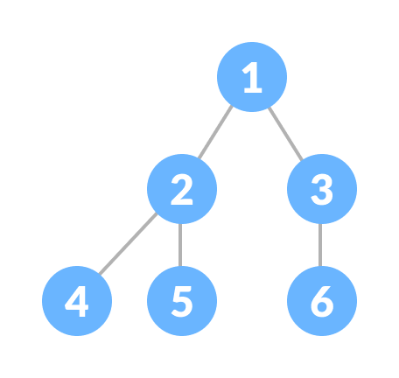
Binary Tree
Complete Binary Tree
  A complete binary tree is a binary tree in which all the levels are completely filled except possibly the lowest one, which is filled from the left.
  A complete binary tree is just like a full binary tree, but with two major differences
    All the leaf elements must lean towards the left.
    The last leaf element might not have a right sibling i.e. a complete binary tree doesn't have to be a full binary tree.

Slide 50
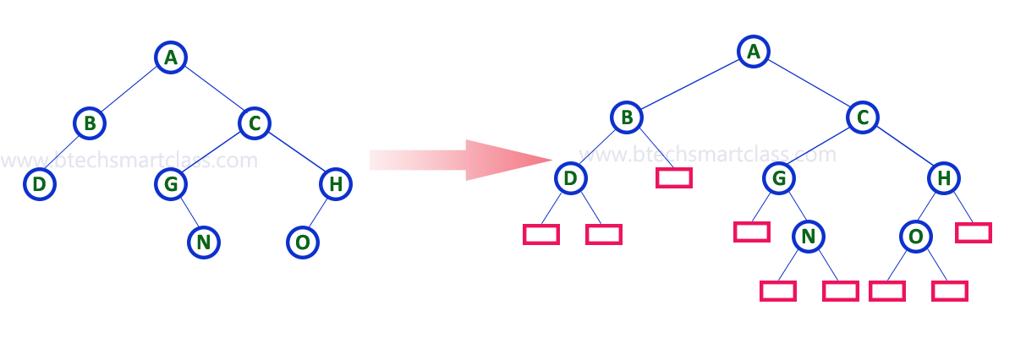
Binary Tree
Extended Binary Tree
  The full binary tree obtained by adding dummy nodes to a binary tree is called as Extended Binary Tree.

Slide 51
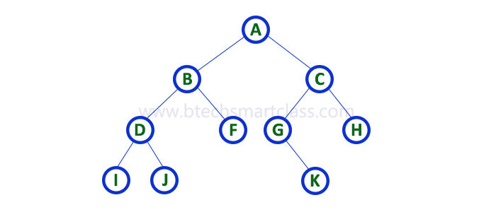
Binary Tree Representation (CO1)
A binary tree data structure is represented using two methods. Those methods are as follows...
  Array Representation
  Linked List Representation
Consider the following binary tree...

Slide 52

Binary Tree Representation
Array Representation of Binary Tree
  In array representation of a binary tree, we use one-dimensional array (1-D Array) to represent a binary tree.
  Consider the above example of a binary tree and it is represented as follows...
  To represent a binary tree of depth 'n' using array representation, we need one dimensional array with a maximum size of 2n + 1.

Slide 53

Binary Tree Representation
Linked List Representation of Binary Tree
  We use a double linked list to represent a binary tree.
  In a double linked list, every node consists of three fields.
  First field for storing left child address, second for storing actual data and third for storing right child address.
  In this linked list representation, a node has the following structure...

Slide 54
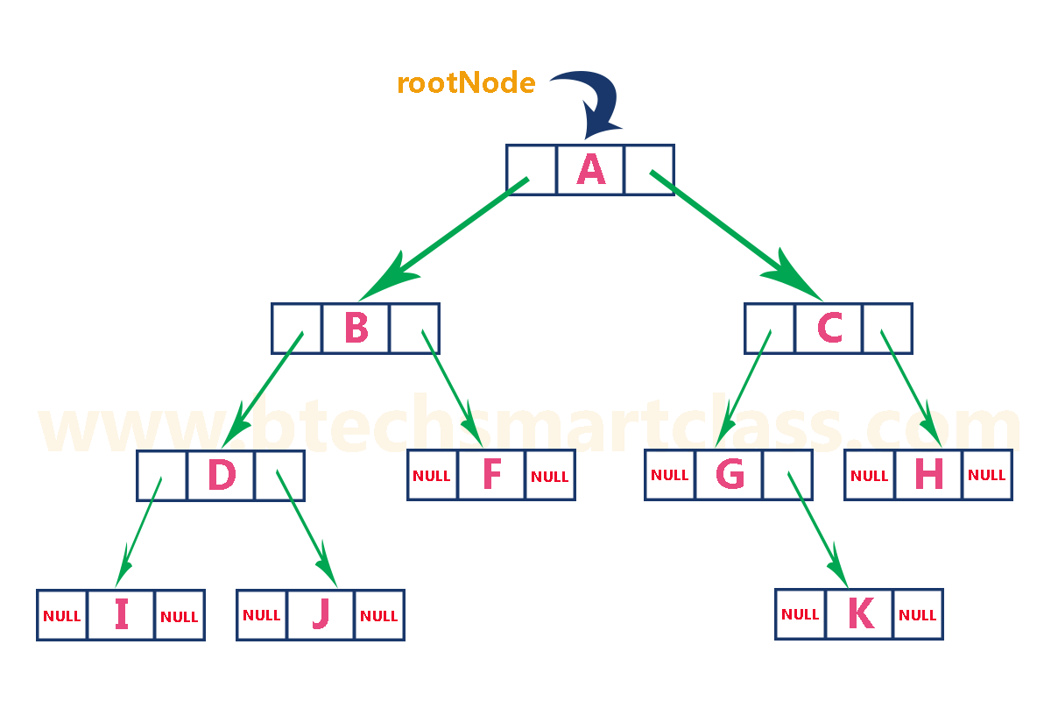
Binary Tree Representation
Linked List Representation of Binary Tree (contd..)
  The above example of the binary tree represented using Linked list representation is shown as follows...

Slide 55
Binary Tree Traversal (CO1)
Displaying (or) visiting order of nodes in a binary tree is called as Binary Tree Traversal.
There are three types of binary tree traversals.
  In - Order Traversal
  Pre - Order Traversal
  Post - Order Traversal
Consider the following binary tree...

Slide 56
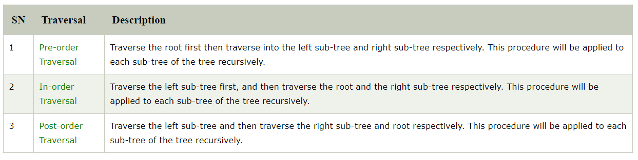
Binary Tree Traversal
  Preorder (Node,Left,Right)
  Postorder (Left, Right, Node)
  Inorder(Left, Node, Right)

Slide 57
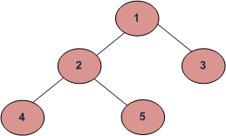
Binary Tree Traversal
(a) Inorder (Left, Node, Right) : 4 2 5 1 3
(b) Preorder (Node, Left, Right) : 1 2 4 5 3
(c) Postorder (Left, Right, Node) : 4 5 2 3 1

Slide 58
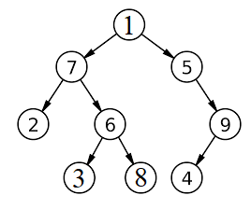
Trees
PreOrder : (NLR)
Ans – 1 7 2 6 3 8 5 9 4
InOrder: (LNR)
Ans – 2 7 3 6 8 1 5 9 4
PostOrder: (LRN)
Ans - 2 3 8 6 7 4 9 5 1

Slide 59
Trees
Algorithm Inorder(tree)
1. Traverse the left subtree, i.e., call Inorder(left-subtree)
2. Visit the root.
3. Traverse the right subtree, i.e., call Inorder(right-subtree)
Algorithm Preorder(tree)
1. Visit the root.
2. Traverse the left subtree, i.e., call Preorder(left-subtree)
3. Traverse the right subtree, i.e., call Preorder(right-subtree)
Algorithm Postorder(tree)
1. Traverse the left subtree, i.e., call Postorder(left-subtree)
2. Traverse the right subtree, i.e., call Postorder(right-subtree)
3. Visit the root.

Slide 60
Construct Tree from given Inorder and Postorder traversals
Trees
Pickup last key of post order sequence and create node of each.
Create left subtree of root node recursively by selecting keys which are preceding the root node in Inorder.
Create right subtree of root node recursively by selecting keys which are following the root node in Inorder

Slide 61
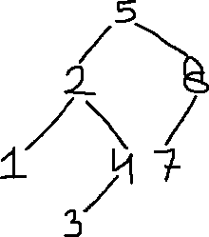
Construct Tree from given Inorder and Postorder traversals
Trees
Inorder: 1 2 3 4 5 7 8
Postorder: 1 3 4 2 7 8 5

Slide 62
Construct Tree from given Inorder and Preorder traversals
Trees
Pickup first key of pre order sequence and create node of each.
Create left subtree of root node recursively by selecting keys which are preceding the root node in Inorder.
Create right subtree of root node recursively by selecting keys which are following the root node in Inorder

Slide 63
Construct Tree from given Inorder and Preorder traversals
Trees
Inorder: 1 2 3 4 5 7 8
Preorder: 5 2 1 4 3 8 7
Inorder: 1 2 3 4 5 6 7 8
Preorder: 5 3 1 2 4 6 8 7

Slide 64
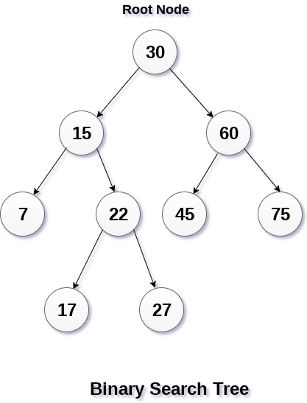
Binary Search Tree (CO1)
Binary Search or ordered binary tree can be defined as a class of binary trees, in which the nodes are arranged in a specific order
In a binary search tree, the value of all the nodes in the left sub-tree is less than the value of the root.
Similarly, value of all the nodes in the right sub-tree is greater than or equal to the value of the root.
This rule will be recursively applied to all the left and right sub-trees of the root.

Slide 65
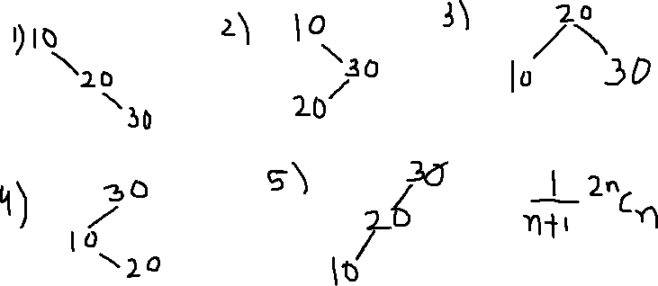
Binary Search Tree Representation
Trees
Construct all possible Binary Search tree by inserting following keys in any order.
10, 20,30

Slide 66
Binary Search Tree
Advantages of using binary search tree
  Searching become very efficient in a binary search tree since, we get a hint at each step, about which sub-tree contains the desired element.
  The binary search tree is considered as efficient data structure in compare to arrays and linked lists.
  In searching process, it removes half sub-tree at every step. Searching for an element in a binary search tree takes o(log₂n) time. In worst case, the time it takes to search an element is 0(n).
  It also speed up the insertion and deletion operations as compare to that in array and linked list.

Slide 67
Binary Search Tree
Operations on Binary Search Tree
SN | Operation | Description
1 | Searching in BST | Finding the location of some specific element in a binary search tree.
2 | Insertion in BST | Adding a new element to the binary search tree at the appropriate location so that the property of BST do not violate.
3 | Deletion in BST | Deleting some specific node from a binary search tree. However, there can be various cases in deletion depending upon the number of children, the node have.

Slide 68
Binary Search Tree
Creation or Insertion of binary search tree
  Create the binary search tree using the following data elements.
  43, 10, 79, 90, 12, 54, 11, 9, 50
  Insert 43 into the tree as the root of the tree.
  Read the next element, if it is lesser than the root node element, insert it as the root of the left sub-tree.
  Otherwise, insert it as the root of the right of the right sub-tree.
The process of creating BST by using the given elements, is shown in next slide

Slide 69
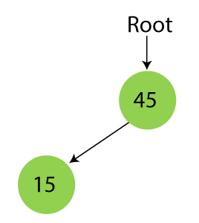
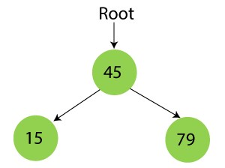
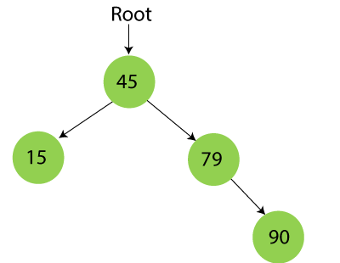

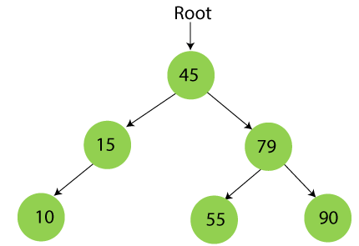
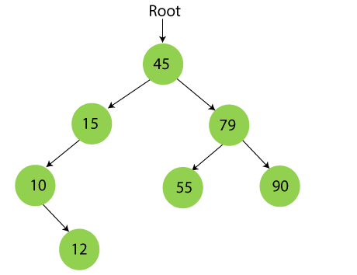
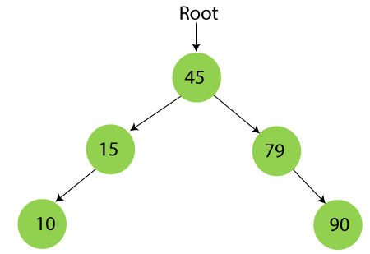
Binary Search Tree

Slide 70
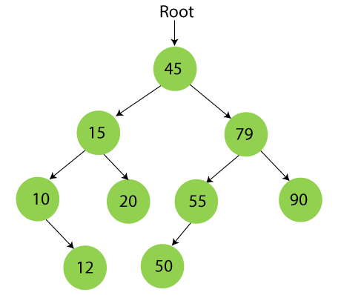
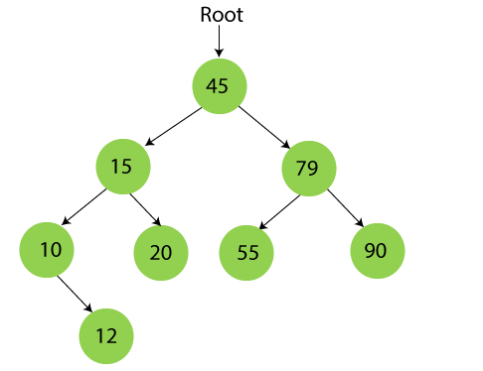
Contd..

Slide 71
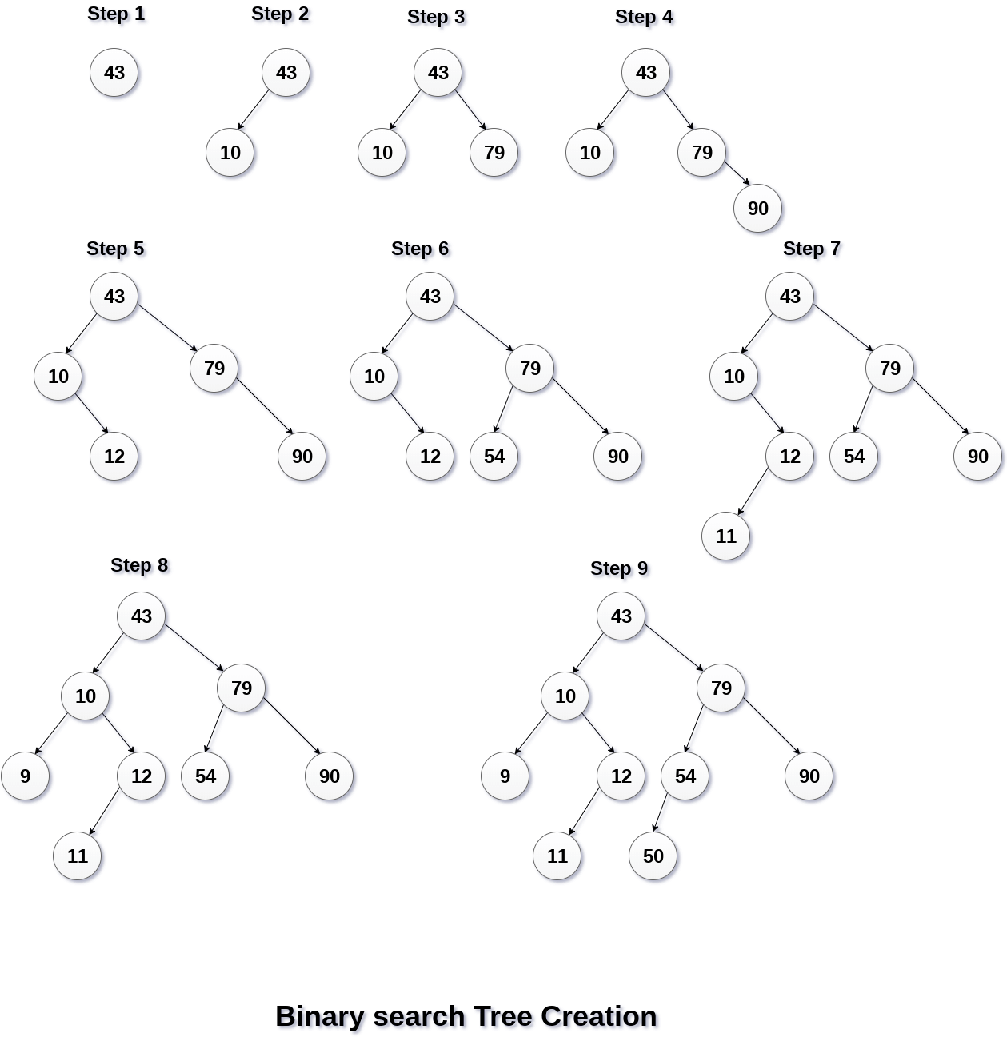
Binary Search Tree
Creation or Insertion of binary search tree (contd..)

Slide 72
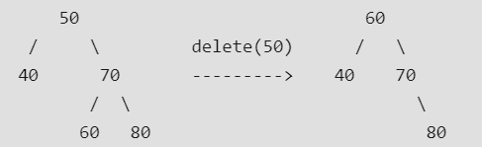
Binary Search Tree Deletion
Binary Search Tree
Case 3 : Deleting the node which has left subtree or right subtree.
Task 1 : Finding key takes either log2(n) or O(n) times.
Task 2 : Replace the deleted node with the max of LST or min of RST.

Slide 73
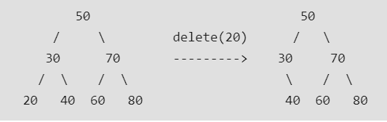
Binary Search Tree Deletion
Binary Search Tree
Case 1 : Deleting the leaf node from BST
Task 1 : Finding key takes either log2(n) or O(n) times.
Task 2 : Identify leaf node parent pointer which is pointing to it and make it NULL.

Slide 74
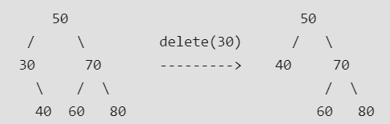
Binary Search Tree Deletion
Binary Search Tree
Case 2 : Deleting the node which has only one child
Task 1 : Finding key takes either log2(n) or O(n) times.
Task 2 : Copy the child to the node and delete the child

Slide 75
Time Complexity
Operations | Best case time complexity | Average case time complexity | Worst case time complexity
Insertion | O(log n) | O(log n) | O(n)
Deletion | O(log n) | O(log n) | O(n)
Search | O(log n) | O(log n) | O(n)

Slide 76
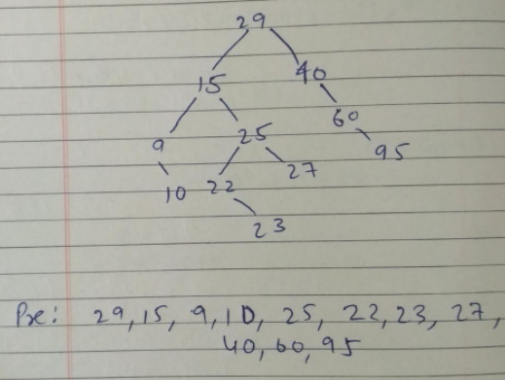
Binary Search Tree Representation
Trees
Post Order Traversal of BST is 10,9,23,22,27,25,15,95,60,40,29.
Find PreOrder traversal.

Slide 77
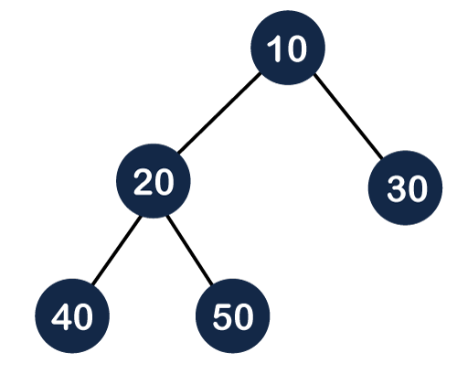
Binary Heap
A heap is a complete binary tree, and the binary tree is a tree in which the node can have at most two children.
A complete binary tree is a binary tree in which all the levels except the last level, i.e., leaf node should be completely filled, and all the nodes should be left-justified.

Slide 78
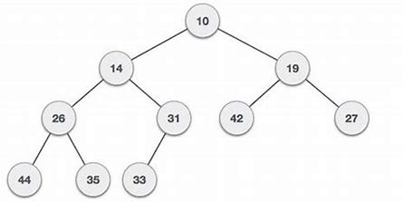
Binary Heap
There are two types of the heap:
  Min Heap
  Max heap
Min Heap
The value of the parent node should be less than or equal to either of its children.

Slide 79
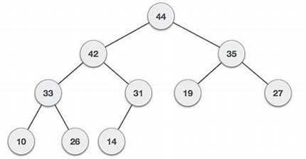
Max Heap
The value of the parent node is greater than or equal to its children.

Slide 80
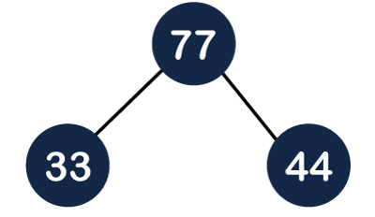
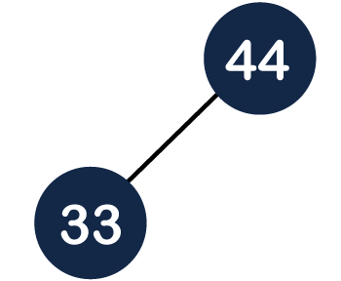

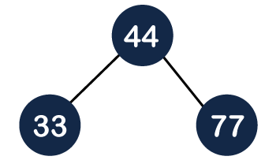
Insertion in a Heap tree
44, 33, 77, 11, 55, 88, 66
Suppose we want to create the max heap tree. To create the max heap tree, we need to consider the following two cases:
  First, we have to insert the element in such a way that the property of the complete binary tree must be maintained.
  Secondly, the value of the parent node should be greater than the either of its child.

Slide 81

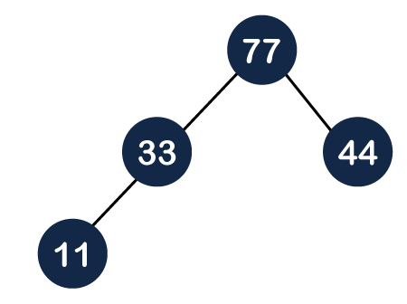
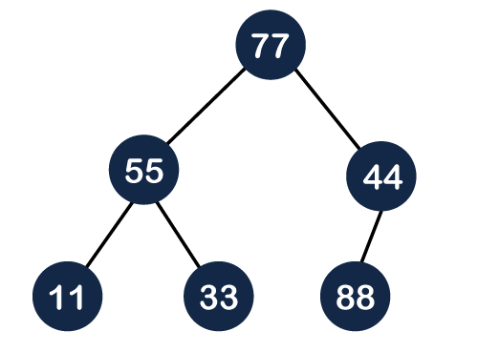

Insertion in a Heap tree

Slide 82
Binary Heap
It is a Complete Tree. This property of Binary Heap makes them suitable to be stored in an array.
A Binary Heap is either Min Heap or Max Heap.
In a Min Binary Heap, the key at the root must be minimum among all keys present in Binary Heap. The same property must be recursively true for all nodes in Binary Tree.
Similarly, in a Max Binary Heap, the key at the root must be maximum among all keys present in Binary Heap. The same property must be recursively true for all nodes in Binary Tree.

Slide 83
Operation on Binary Heap
insert(p): Inserts a new element with priority p.
extractMax(): Extracts an element with maximum priority.
getMax(): Returns an element with maximum priority.
IncreaseKey(i, p): Increase the priority of an element pointed by i to p.

Slide 84
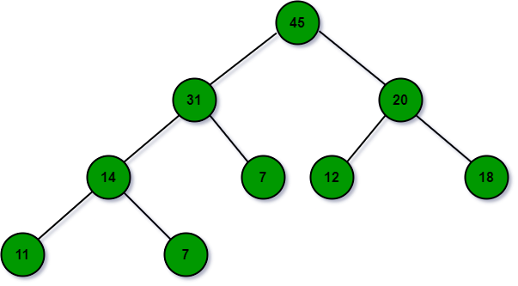
Insert 32 in this tree

Slide 85



Slide 86
Extract Max

Slide 87


Extract Max

Slide 88
Change Priority/Increase Key
Change the priority of nodes 11 to 35

Slide 89
Priority Queue Algorithm
Algorithm to find number with highest priority
Heap_Maximum(A)
return A[1]
Running Time Constant (1)

Slide 90
Priority Queue Algorithm
Algorithm to find number with highest priority
and swap with first element.
Heap_Extract_Maximum(A, heap_size)
if A.heap_size<1
error “heap underflow”
Max = A[1]
A[1] = A[heap_size]
heap_size = heap_size-1
Max_heapify(A,1)
return max
Running Time –
O(log₂ n)

Slide 91
Heap-Increase-Key(A, i, key)
  Heap-Increase-Key(A, i, key)
  // Input: A: an array representing a heap, i: an array index, key: a new key greater than A[i]
  // Output: A still representing a heap where the key of A[i] was increased to key
  // Running Time: O(log n) where n =heap-size[A]
1 if key < A[i]
2 error(“New key must be larger than current key”)
3 A[i] ← key
4 while i > 1 and A[Parent(i)] < A[i]
5 exchange A[i] and A[Parent(i)]
6 i ← Parent(i)
Running Time –
O(log₂ n)

Slide 92
Max_Heap-Insert(A, key)
Max_Heap-Insert(A, key)
heap_size = heap_size +1
A[heap_size ] = -infinity
Heap-Increase-Key(A, heap_size, key)
Running Time –
O(log₂ n)

Slide 93
Height Balanced Tree: AVL Tree
AVL Tree is invented by GM Adelson - Velsky and EM Landis in 1962. The tree is named AVL in honor of its inventors.
AVL Tree can be defined as height balanced binary search tree in which each node is associated with a balance factor which is calculated by subtracting the height of its right sub-tree from that of its left sub-tree.
Tree is said to be balanced if balance factor of each node is in between -1 to 1, otherwise, the tree will be unbalanced and need to be balanced.
Balance Factor = height(left-subtree) − height(right-subtree)

Slide 94

AVL Tree
BalanceFactor = height(left-subtree) − height(right-subtree)

Slide 95

AVL Tree

Slide 96
AVL Rotations
We perform rotation in AVL tree only in case if Balance Factor is other than -1, 0, and 1.
There are basically four types of rotations which are as follows:
  L L rotation: Inserted node is in the left subtree of left subtree of A
  R R rotation : Inserted node is in the right subtree of right subtree of A
  L R rotation : Inserted node is in the right subtree of left subtree of A
  R L rotation : Inserted node is in the left subtree of right subtree of A
Where node A is the node whose balance Factor is other than -1, 0, 1.
The first two rotations LL and RR are single rotations and the next two rotations LR and RL are double rotations.

Slide 97

Left Rotation/RR Rotation
If a tree becomes unbalanced, when a node is inserted into the right subtree of the right subtree, then we perform a single left rotation.
In this example, node A has become unbalanced as a node is inserted in the right subtree of A's right subtree.
We perform the left rotation by making A the left-subtree of B.

Slide 98

Right Rotation/LL Rotation
AVL tree may become unbalanced, if a node is inserted in the left subtree of the left subtree.
The tree then needs a right rotation.
As depicted, the unbalanced node becomes the right child of its left child by performing a right rotation.

Slide 99


Right Rotation/LL Rotation
The second type of double rotation is Right-Left Rotation. It is a combination of right rotation followed by left rotation.
State | Action
 | A node has been inserted into the left subtree of the right subtree. This makes A, an unbalanced node with balance factor 2.
 | First, we perform the right rotation along C node, making C the right subtree of its own left subtree B. Now, B becomes the right subtree of A.

Slide 100



Right Rotation/LL Rotation
 | Node A is still unbalanced because of the right subtree of its right subtree and requires a left rotation.
 | A left rotation is performed by making B the new root node of the subtree. A becomes the left subtree of its right subtree B.
 | The tree is now balanced.

Slide 101

AVL Tree
Q: Construct an AVL tree having the following elements
H, I, J, B, A, E, C, F, D, G, K, L
1. Insert H, I, J

Slide 102


AVL Tree
On inserting the above elements, especially in the case of H, the BST becomes unbalanced as the Balance Factor of H is -2.
Since the BST is right-skewed, we will perform RR Rotation on node H.
The resultant balance tree is:
2. Insert B, A

Slide 103

AVL Tree
On inserting the above elements, especially in case of A, the BST becomes unbalanced as the Balance Factor of H and I is 2, we consider the first node from the last inserted node i.e. H.
Since the BST from H is left-skewed, we will perform LL Rotation on node H.
The resultant balance tree is:

Slide 104

AVL Tree
3. Insert E
On inserting E,
BST becomes unbalanced as the Balance Factor of I is 2, since if we travel from E to I we find that it is inserted in the left subtree of right subtree of I,
we will perform LR Rotation on node I. LR = RR + LL rotation

Slide 105

AVL Tree
3 a) We first perform RR rotation on node B
The resultant tree after RR rotation is:

Slide 106

AVL Tree
3b) We first perform LL rotation on the node I
The resultant balanced tree after LL rotation is:

Slide 107

AVL Tree
4. Insert C, F, D
On inserting C, F, D, BST becomes unbalanced as the Balance Factor of B and H is -2, since if we travel from D to B we find that it is inserted in the right subtree of left subtree of B,
we will perform RL Rotation on node I. RL = LL + RR rotation.

Slide 108

AVL Tree
4a) We first perform LL rotation on node E
The resultant tree after LL rotation is:

Slide 109

AVL Tree
4b) We then perform RR rotation on node B
The resultant balanced tree after RR rotation is:

Slide 110

AVL Tree
5. Insert G
On inserting G, BST become unbalanced as the Balance Factor of H is 2, since if we travel from G to H, we find that it is inserted in the left subtree of right subtree of H, we will perform LR Rotation on node I.
LR = RR + LL rotation.

Slide 111

AVL Tree
6. Insert K
On inserting K, BST becomes unbalanced as the Balance Factor of I is -2.
Since the BST is right-skewed from I to K, hence we will perform RR Rotation on the node I.

Slide 112

AVL Tree
The resultant balanced tree after RR rotation is:

Slide 113

AVL Tree
7. Insert L
On inserting the L tree is still balanced as the Balance Factor of each node is now either, -1, 0, +1. Hence the tree is a Balanced AVL tree

Slide 114
AVL Tree
Deletion in AVL Tree
Deleting a node from an AVL tree is similar to that in a binary search tree. Deletion may disturb the balance factor of an AVL tree and therefore the tree needs to be rebalanced in order to maintain the AVLness.
For this purpose, we need to perform rotations.
The two types of rotations are L rotation and R rotation.
If the node which is to be deleted is present in the left sub-tree of the critical node, then L rotation needs to be applied else if, the node which is to be deleted is present in the right sub-tree of the critical node, the R rotation will be applied.
Let us consider that, A is the critical node and B is the root node of its left sub-tree.
If node X, present in the right sub-tree of A, is to be deleted, then there can be three different situations:

Slide 115

AVL Tree
R0 rotation (Node B has balance factor 0 )
If the node B has 0 balance factor, and the balance factor of node A disturbed upon deleting the node X, then the tree will be rebalanced by rotating tree using R0 rotation.
The critical node A is moved to its right and the node B becomes the root of the tree with T1 as its left sub-tree. The sub-trees T2 and T3 becomes the left and right sub-tree of the node A. the process involved in R0 rotation is shown in the following image.

Slide 116

AVL Tree
Example:
Delete the node 30 from the AVL tree shown in the following image.
Solution
In this case, the node B has balance factor 0, therefore the tree will be rotated by using R0 rotation as shown in the following image. The node B(10) becomes the root, while the node A is moved to its right. The right child of node B will now become the left child of node A.

Slide 117

AVL Tree
R1 Rotation (Node B has balance factor 1)
R1 Rotation is to be performed if the balance factor of Node B is 1. In R1 rotation, the critical node A is moved to its right having sub-trees T2 and T3 as its left and right child respectively. T1 is to be placed as the left sub-tree of the node B.
The process involved in R1 rotation is shown in the following image.

Slide 118

AVL Tree
Example
Delete Node 55 from the AVL tree shown in the following image.
Deleting 55 from the AVL Tree disturbs the balance factor of the node 50 i.e. node A which becomes the critical node. This is the condition of R1 rotation in which, the node A will be moved to its right (shown in the image below). The right of B is now become the left of A (i.e. 45).
The process involved in the solution is shown in the following image.

Slide 119

AVL Tree
R-1 Rotation (Node B has balance factor 1)
R-1 rotation is to be performed if the node B has balance factor -1. This case is treated in the same way as LR rotation. In this case, the node C, which is the right child of node B, becomes the root node of the tree with B and A as its left and right children respectively.
The sub-trees T1, T2 becomes the left and right sub-trees of B whereas, T3, T4 become the left and right sub-trees of A.
The process involved in R-1 rotation is shown in the following image.

Slide 120

AVL Tree
Example
Delete the node 60 from the AVL tree shown in the following image.
Solution:
in this case, node B has balance factor -1. Deleting the node 60, disturbs the balance factor of the node 50 therefore, it needs to be R-1 rotated. The node C i.e. 45 becomes the root of the tree with the node B(40) and A(50) as its left and right child.

Slide 121
Threaded Binary Tree(CO1)
Introduction
A binary tree can be represented using array representation or linked list representation. When a binary tree is represented using linked list representation, the reference part of the node which doesn't have a child is filled with NULL pointer. In any binary tree linked list representation, there are more number of NULL pointers than actual pointers. Generally, in any binary tree linked list representation, if there are 2N number of reference fields, then N+1 number of reference fields are filled with NULL ( N+1 are NULL out of 2N ).
This NULL pointer does not play any role except indicating that there is no link (no child).
A. J. Perlis and C. Thornton have proposed new binary tree called "Threaded Binary Tree", which makes use of NULL pointers to improve its traversal process. In threaded binary tree, NULL pointers are replaced by references of other nodes in the tree. These extra references are called as threads.

Slide 122
TBT Contd…
Threaded Binary Tree is also a binary tree in which all left child pointers that are NULL (in Linked list representation) points to its in-order predecessor, and all right child pointers that are NULL (in Linked list representation) points to its in-order successor.
If there is no in-order predecessor or in-order successor, then it points to the root node.
Consider the following binary tree...

Slide 123

TBT Contd…
In-order traversal of above binary tree: H - D - I - B - E - A - F - J - C - G
When we represent the above binary tree using linked list representation, nodes H, I, E, F, J and G left child pointers are NULL. This NULL is replaced by address of its in-order predecessor respectively, but here the node H does not have its in-order predecessor, so it points to the root node A. And nodes H, I, E, J and G right child pointers are NULL. This NULL pointers are replaced by address of its in-order successor respectively, but here the node G does not have its in-order successor, so it points to the root node A.

Slide 124

Types of TBT
There are two types of threaded binary trees:
Single Threaded: each node is threaded towards either the in-order predecessor or successor (left orright) means all right null pointers will point to inorder successor OR all left null pointers will point to inorder predecessor.
Double threaded: each node is threaded towards both the in-order predecessor and successor (left andright) means all right null pointers will point to inorder successor AND all left null pointers will point to inorder predecessor.

Slide 125
TBT Node Implementation
Defining the TBT Node
struct TBTNode
{
struct TBTNode *Lchild, *Rchild;
int data;
boolean Lbit;
boolean Rbit;
};
Lbit
Lchild
Data
Rchild
Rbit
TBT Node Structure

Slide 126
    Traversing a Threaded Binary Tree
For every node, visit the left sub-tree first, provided if one exists and has not been visited earlier. Then the node (root) itself is followed by visiting its right sub-tree (if one exists). In case there is no right sub-tree, check for the threaded link and make the threaded node the current node in consideration.
The algorithm for in-order traversal of a threaded binary tree is
  Step 1: check if the current node has a left child that has not been visited. If a left child exists that has not been visited, go to Step 2, else go to Step 3.
  Step 2: add the left child in the list of visited nodes. Make it as the current node and then go to Step 6.
  Step 3: If the current node has a right child, go to Step 4 else go to Step 5.
  Step 4: Make that right child as current node and go to Step 6.
  Step 5: print the node and if there is a threaded node make it the current node.
  Step 6: If all the nodes have visited then END else go to Step 1.

Slide 127
TBT inorder traversal
Inorder Taversal using Threads
Following is C++ code for inorder traversal in a threaded binary tree.
struct Node* leftMost(struct Node *n)
{
if (n == NULL)
return NULL;
while (n->left != NULL)
n = n->left;
return n;
}
void inOrder(struct Node *root)
{
struct Node *cur = leftmost(root);
while (cur != NULL)
{
cout<<cur->data;
// If this node is a thread node, then go to
// inorder successor
if (cur->rightThread)
cur = cur->right;
else // Else go to the leftmost child in right subtree
cur = leftmost(cur->right);
}
}
153

Slide 128

In the Example

Slide 129
TBT Advantages
Advantages of Threaded Binary Tree
It enables linear traversal of elements in the tree.
Linear traversal eliminates the use of stacks which in turn consume a lot of memory space and computer time.
It enables to find the parent of a given element without explicit use of parent pointers.
Since nodes contain pointers to in-order predecessor and successor, the threaded tree enables forward and backward traversal of the nodes as given by in-order fashion.

Slide 130
Insertion in TBT
Insertion in Binary threaded tree is similar to insertion in binary tree but we will have to adjust the threads after insertion of each element.
Defining the TBT Node
struct TBTNode
{
struct TBTNode *Lchild, *Rchild;
int data;
boolean Lbit;
boolean Rbit;
};
Lbit
Lchild
Data
Rchild
Rbit
TBT Node Structure

Slide 131
Insertion in TBT
There can be three cases during insertion:
Case 1: Insertion in empty tree
Both left and right pointers of tmp will be set to NULL and new node becomes the root.
root = tmp;
tmp -> left = NULL;
tmp -> right = NULL;
Case 2: When new node inserted as the left child
After inserting the node at its proper place we have to make its left and right threads points to inorder predecessor and successor respectively.
The node which was inorder successor. So the left and right threads of the new node will be-
tmp -> left = par ->left;
tmp -> right = par;
Before insertion, the left pointer of parent was a thread, but after insertion it will be a link pointing to the new node.
par -> lthread = false;
par -> left = temp;

Slide 132
Insertion in TBT

Slide 133
Insertion in TBT
Predecessor of 14 becomes the predecessor of 13, so left thread of 13 points to 10.
Successor of 13 is 14, so right thread of 13 points to left child which is 13.
Left pointer of 14 is not a thread now, it points to left child which is 13.

Slide 134
Insertion in TBT
Case 3: When new node is inserted as the right child
The parent of tmp is its inorder predecessor. The node which was inorder successor of the parent is now the inorder successor of this node tmp.
So the left and right threads of the new node will be-
tmp -> left = par;
tmp -> right = par -> right;
Before insertion, the right pointer of parent was a thread, but after insertion it will be a link pointing to the new node.
par -> rthread = false;
par -> right = tmp;

Slide 135
Insertion in TBT

Slide 136

Insertion in TBT
Successor of 14 becomes the successor of 15, so right thread of 15 points to 16
Predecessor of 15 is 14, so left thread of 15 points to 14.
Right pointer of 14 is not a thread now, it points to right child which is 15.

Slide 137

Huffman Coding

Slide 138
Huffman Coding
Huffman Coding is a famous Greedy Algorithm.
It is used for the lossless compression of data.
It uses variable length encoding.
It assigns variable length codes to all the characters depending on how frequently they occur in the given text.
The character which occurs most frequently gets the smallest code.
The character which occurs least frequently gets the largest code.
It is also known as Huffman Encoding.

Slide 139
Prefix Rule-
Huffman Coding
To prevent ambiguities while decoding, Huffman coding implements a rule known as a prefix rule.
It ensures that the code assigned to any character is not a prefix of the code assigned to any other character.
Major Steps in Huffman Coding-
There are two major steps in Huffman coding-
Building a Huffman tree from the input characters.
Assigning codes to the characters by traversing the Huffman tree.

Slide 140
Huffman Coding
The steps involved in the construction of Huffman Tree are as follows-
Step-01:
Create a leaf node for all the given characters.
Leaf node contains the occurring frequency of that character.
Step-02:
Arrange all the nodes in increasing order of their frequency value.

Slide 141
Huffman Coding
Considering the first two nodes having minimum frequency,
Create a new internal node.
The frequency of this node is the sum of the frequency of those two nodes.
Make the first node as a left child and the other node as a right child of the newly created node.
Step-04:
Keep repeating Step-02 and Step-03 until all the nodes form a single tree.
The tree finally obtained will be the desired Huffman Tree.

Slide 142

Important Formulas-
Huffman Coding
Formula-01:

Slide 143
Huffman Coding
Formula-02:
Total number of bits in Huffman encoded message
= Total number of characters in the message x Average code length per character
= ∑ ( frequencyi x Code lengthi )

Slide 144
Huffman Coding
PRACTICE PROBLEM BASED ON HUFFMAN CODING-
Problem-
A file contains the following characters with the frequencies as shown. If Huffman coding is used for data compression, determine-
Huffman code for each character
Average code length
Length of Huffman encoded message (in bits)

Slide 145
Huffman Coding
Characters | Frequencies
a | 10
e | 15
i | 12
o | 3
u | 4
s | 13
t | 1

Slide 146


Huffman Coding
Solution-
First let us construct the Huffman Tree.
Huffman Tree is constructed in the following steps-
Step-01:
Step-02:

Slide 147

Step-03:
Huffman Coding

Slide 148

Step-04:
Huffman Coding

Slide 149

Step-05:
Huffman Coding

Slide 150

Step-06:
Huffman Coding

Slide 151

Step-07:
Huffman Coding

Slide 152
Huffman Coding
Now,
We assign weight to all the edges of the constructed Huffman tree.
Let us assign weight ‘0’ to the left edges and weight ‘1’ to the right edges.
Rule
If you assign weight ‘0’ to the left edges, then assign weight ‘1’ to the right edges.
If you assign weight ‘1’ to the left edges, then assign weight ‘0’ to the right edges.
But follow the same convention at the time of decoding that was adopted at the time of encoding.
After assigning weight to all the edges, the modified Huffman Tree is-

Slide 153

Huffman Coding
Now, let us answer each part of the problem one by one-

Slide 154
Huffman Coding
1. Huffman Code For The Characters-
To write Huffman Code for a character, traverse the Huffman tree from root node to all the leaf node of that character.
Following this rule, the Huffman Code for each character is-
a = 111
e = 10
i = 00
o = 11001
u = 1101
s = 01
t = 11000

Slide 155
Huffman Coding
From here, We can observe-
Characters occurring less frequently in the text are assigned the larger code.
Characters occurring more frequently in the text are assigned the smaller code.
2. Average Code Length-
Average code length
= ∑ ( frequencyi x code lengthi ) / ∑ ( frequencyi )
= { (10 x 3) + (15 x 2) + (12 x 2) + (3 x 5) + (4 x 4) + (13 x 2) + (1 x 5) } / (10
+ 15 + 12 + 3 + 4 + 13 + 1)
= 2.52

Slide 156
Huffman Coding
3. Length of Huffman Encoded Message-
Total number of bits in Huffman encoded message
= Total number of characters in the message x Average code length per character
= 58 x 2.52
= 146.16
≅ 147 bits

Slide 157
Greedy Algorithm (CO1)
Huffman Coding
Notes:
BSBSwh hwhhdwhw kq1kedbfceJCQK ;DW[
LMHYI;’
;LI

Slide 158

Greedy Algorithm (CO1)
Huffman Coding

Slide 159

Greedy Algorithm (CO1)
Huffman Coding
We again sort the nodes according to the values and repeat the same process with the first two nodes.

Slide 160

s.
Greedy Algorithm (CO1)
Huffman Coding

Slide 161

s.
Greedy Algorithm (CO1)
Huffman Coding

Slide 162

s.
Greedy Algorithm (CO1)
Huffman Coding

Slide 163
Sorting(CO1)
Heap Sort
Heap sort is a comparison based sorting technique based on Binary Heap data structure.
The binary heap data structure is an array that can be viewed as almost complete binary tree.
Each node of the binary tree corresponds to an element of the array.
It is similar to selection sort where we first find the maximum element and place the maximum element at the end.
We repeat the same process for remaining element.

Slide 164

Sorting(CO1)
Heap Sort
For Example
We represent heaps in level order, going from left to right.
The array corresponding to the heap above is [25, 13, 17, 5, 8, 3].

Slide 165
Sorting(CO1)
Heap Sort
The root of the tree A[1] and given index i of a node, the indices of its parent, left child and right child can be computed as
PARENT (i) = return floor(i/2)
LEFT (i) = return 2i
RIGHT (i) = return 2i + 1

Slide 166

Sorting(CO1)
Heap Property
Max-heap property: A max-heap is a binary tree such that. - the data contained in each node is greater than (or equal to) the data in that node's children. ie. for every node i other than the root
A[PARENT(i)] >= A[i]

Slide 167

Sorting(CO1)
2. Min-heap property: A min-heap is a binary tree such that. - the data contained in each node is less than (or equal to) the data in that node's children. - the binary tree is complete
for every node i other than the root
A[PARENT(i)] <= A[i]

Slide 168
Sorting(CO1)
Four basic procedures on heap are
1. Heapify, which runs in O(lg n) time.
2. Build-Heap, which runs in linear time.
3. Heap Sort, which runs in O(n lg n) time.
4. Extract-Max, which runs in O(lg n) time.

Slide 169
Sorting(CO1)
Heapify (A, i)
1. l ← left [i]
2. r ← right [i]
3. if l ≤ heap-size [A] OR A[l] > A[i]
4. then largest ← l
5. else largest ← i
6. if r ≤ heap-size [A] OR A[r] > A[largest]
7. then largest ← r
8. if largest ≠ i
9. then exchange A[i] ↔ A[largest]
10. Heapify (A, largest)

Slide 170
Sorting(CO1)
Build Max Heap (A)
1. heap-size [A] ← length [A]
2. For i ← lower bound (length [A])/2 down to 1
Do Max Heapify [A, i]
HeapSort (A,n)
{
Build Max Heap (A)
heapsize = n
for i = n to 2 do
t = A[1]
A[1] = A[i]
A[i] = t
heapsize = heapsize – 1
heapify(A,1,heapsize)
}

Slide 171
Sorting(CO1)
Characteristics of Heap Sort Algorithm
The heap sort combines the best of both merge sort and insertion sort. Like merge sort, the worst case time of heap sort is O(n log n) and like insertion sort, heap sort sorts in-place.
The heap sort algorithm starts by using procedure BUILD-HEAP to build a heap on the input array A[1 . . n].
Since the maximum element of the array stored at the root A[1], it can be put into its correct final position by exchanging it with A[n] (the last element in A).
If we now discard node n from the heap than the remaining elements can be made into heap. Note that the new element at the root may violate the heap property.

Slide 172
Sorting(CO1)
Heap Sort Algorithm
HEAPSORT (A)
1. BUILD_HEAP (A)
2. for i ← length (A) down to 2 do
exchange A[1] ↔ A[i]
heap-size [A] ← heap-size [A] - 1
Heapify (A, 1)
The HEAPSORT procedure takes time O(n lg n), since the call to BUILD_HEAP takes time O(n) and each of the n -1 calls to Heapify takes time O(lg n).

Slide 173

Sorting(CO1)
Example: A=[7, 4, 3, 1, 2]

Slide 174
Priority Queue
A priority queue is a type of queue that arranges elements based on their priority values.
Elements with higher priority values are typically retrieved before elements with lower priority values.

Slide 175
Daily Quiz
The number of edges from the root to the node is called __________ of the tree.
a) Height
b) Depth
c) Length
d) Width
What is a full binary tree?
a) Each node has exactly zero or two children
b) Each node has exactly two children
c) All the leaves are at the same level
d) Each node has exactly one or two children
What is the average case time complexity for finding the height of the binary tree?
a) h = O(loglogn)
b) h = O(nlogn)
c) h = O(n)
d) h = O(log n)

Slide 176
MCQ s
Which of the following is the most widely used external memory data structure?
a) AVL tree
b) B-tree
c) Red-black tree
d) Both AVL tree and Red-black tree
B-tree of order n is a order-n multiway tree in which each non-root node contains __________
a) at most (n – 1)/2 keys
b) exact (n – 1)/2 keys
c) at least 2n keys
d) at least (n – 1)/2 keys

Slide 177
Weekly Assignment
Define tree data structure with its terminologies.
Construct expression tree for the following expressions
  A + (B * (C / D) )
  (a + b*c) * ( d + e)
Prove that the number of leaves in a non-empty full binary tree is one more than the number of internal nodes.
Construct a binary tree if the in-order and post-order traversal is given
Construct a binary tree if the in-order and pre-order traversal is given
  Inorder : 10, 15, 17, 18, 20, 25, 30, 35, 38, 40, 50
  Preorder: 20, 15, 10, 18, 17, 30, 25, 40, 35, 38, 50

Slide 178
Weekly Assignment
Create a BST using 28, 56, 12, 9 87, 7, 23, 19
What is the difference between BST and AVL tree?
From a BST with numbers: 28, 56, 12, 9 87, 7, 23, 19. Delete 56.
What is B Tree? How is it different from Binary T
Create an AVL Tree using 39, 56, 2, 9 87, 7, 23, 19

Slide 179
Glossary Question
i. Trees ii. Graphs iii.List iv.Leaf Node
Answer the questions.
a. A finite ,ordered sequence of data items….
b. Any node that has two empty children…
c. Consists of a set of vertices and edges…..
d. Finite set of one or more nodes……

Slide 180
Faculty Video Links, Youtube & NPTEL Video Links and Online Courses Details
Youtube/other Video Links
Binary tree traversal
    https://www.youtube.com/watch?v=e_Wv_pH4Se8
Constructing binary tree from inorder, postorder
  https://www.youtube.com/watch?v=s5XRtcud35E
Constructing binary tree from inorder, preorder
  https://www.youtube.com/watch?v=PoBGyrIWisE
Huffman Coding
  https://www.youtube.com/watch?v=saofdNsZiYY
AVL Tree
  https://www.youtube.com/watch?v=_8qqlVH5NC0
B-tree
  https://www.youtube.com/watch?v=aNU9XYYCHu8

Slide 181

Old Question Papers

Slide 182

Old Question Papers

Slide 183

Old Question Papers

Slide 184
Old Question Papers
http://www.aktuonline.com/papers/btech-cs-3-sem-data-structures-kcs301-2020.html
http://www.aktuonline.com/papers/btech-cs-3-sem-data-structures-rcs-305-2018-19.html
http://www.aktuonline.com/papers/btech-cs-3-sem-data-structures-rcs-305-2017-18.html
http://www.aktuonline.com/papers/btech-cs-3-sem-data-structures-using-c-ncs-301-2016-17.html
https://www.aktuonline.com/papers/btech-cs-3-sem-data-structures-kcs301-2020.html
https://firstranker.com/fr/frdA290120A1345373/download-aktu-b-tech-3rd-sem-2018-2019-data-structures-rcs-305-question-paper

Slide 185
Expected Questions for University Exam
Define extended binary tree, full binary tree, strictly binary tree and complete binary tree.
Explain threaded binary tree.
Can you find a unique tree when any two traversals are given? Using the following traversals construct the corresponding binary tree:
  INORDER: H K D B I L E A F C M J G
  PREORDER: A B D H K E I L C F G J M
Also find the Post Order traversal of obtained tree.
What is a B-Tree? Generate a B-Tree of order 4 with the alphabets (letters) arrive in the sequence as follows: a g f b k d h m j e s i r x c l n t u p
Draw a binary Tree for the expression: A * B - (C + D) * (P /Q)

Slide 186
Expected Questions for University Exam
What is a height balanced Tree? Why height balancing of Tree is required? Create an AVL Tree for the following elements: a, z, b, y, c, x, d, w, e, v, f
Construct a B-tree of order 5 created by inserting the following elements 3, 14, 7, 1, 8, 5, 11, 17, 13, 6, 23, 12, 20, 26, 4, 16, 18, 24, 25, 19 Also delete elements 6, 23 and 3 from the constructed tree

Slide 187
Recap of Unit
Knowledge of tree terminology and different types of trees.
Knowledge of application areas of trees.
Limitation of different trees and how those limitations are removed

Slide 188
References
Aaron M. Tenenbaum, Yedidyah Langsam and Moshe J. Augenstein, “Data Structures Using C and C++”, PHI Learning Private Limited, Delhi India
Horowitz and Sahani, “Fundamentals of Data Structures”, Galgotia Publications Pvt Ltd Delhi India.
Lipschutz, “Data Structures” Schaum’s Outline Series, Tata McGraw-hill Education (India) Pvt. Ltd.
Thareja, “Data Structure Using C” Oxford Higher Education.
AK Sharma, “Data Structure Using C”, Pearson Education India.
Michael T. Goodrich, Roberto Tamassia, David M. Mount “Data Structures and Algorithms in C++”, Wiley India.
. P. S. Deshpandey, “C and Data structure”, Wiley Dreamtech Publication.

Slide 189
Any Query?
Thank You

